Slide 1


初級日本語 [げんき] GENKI: An Integrated Course in Elementary Japanese I Introduction
Dr. Jiajun Bracewell

Slide 2
Objectives
1. Recognizing hiragana syllables and Writing hiragana
2. Recognizing katakana syllables and Writing katakana
3. Voiced consonants
4. Contracted sounds
5. Double consonants
6. Long vowels
7. Greetings

Slide 3
1. Recognizing hiragana syllables and Writing hiragana
n | w- | r- | y- | m- | h- | n- | t- | s- | k-
ん | わ | ら | や | ま | は | な | た | さ | か | あ | a
n | wa | ra | ya | ma | ha | na | ta | sa | ka | a
 |  | り |  | み | ひ | に | ち | し | き | い | i
 |  | ri |  | mi | hi | ni | chi | shi | ki | i
 |  | る | ゆ | む | ふ | ぬ | つ | す | く | う | u
 |  | ru | yu | mu | fu | nu | tsu | su | ku | u
 |  | れ |  | め | へ | ね | て | せ | け | え | e
 |  | re |  | me | he | ne | te | se | ke | e
 | を | ろ | よ | も | ほ | の | と | そ | こ | お | o
 | wo | ro | yo | mo | ho | no | to | so | ko | o

Slide 4
1. Recognizing hiragana syllables and Writing hiragana
5 vowels: あ い う え お
Combine consonants with 5 vowels.

Slide 5
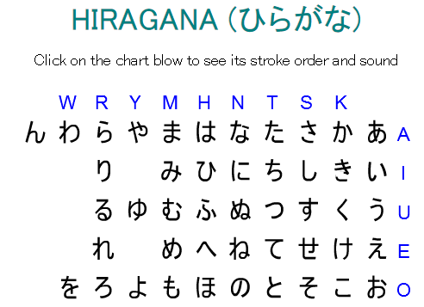
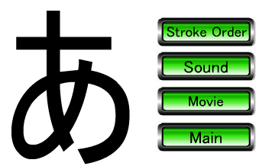
1. Recognizing hiragana syllables and Writing hiragana
http://genki.japantimes.co.jp/site/self/site/hiragana/hiragana.html

Slide 6
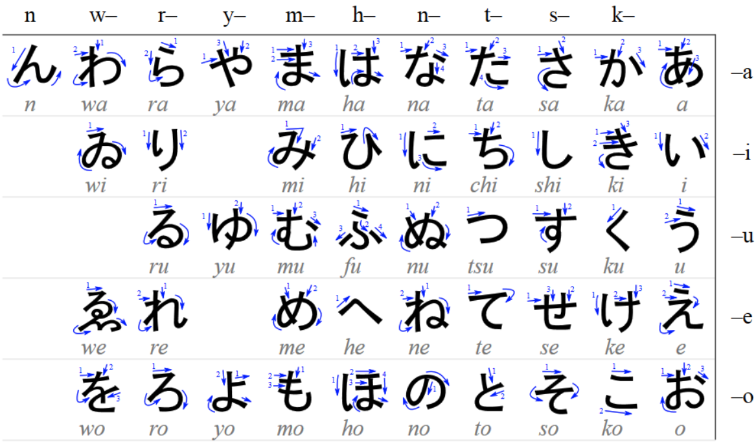
1. Recognizing hiragana syllables and Writing hiragana
https://upload.wikimedia.org/wikipedia/commons/2/28/Table_hiragana.svg

Slide 7
2. Recognizing katakana syllables and Writing katakana
n | w- | r- | y- | m- | h- | n- | t- | s- | k-
ン | ワ | ラ | ヤ | マ | ハ | ナ | タ | サ | カ | ア | a
n | wa | ra | ya | ma | ha | na | ta | sa | ka | a
 |  | リ |  | ミ | ヒ | ニ | チ | シ | キ | イ | i
 |  | ri |  | mi | hi | ni | chi | shi | ki | i
 |  | ル | ユ | ム | フ | ヌ | ツ | ス | ク | ウ | u
 |  | ru | yu | mul | fu | nu | tsu | su | ku | u
 |  | レ |  | メ | ヘ | ネ | テ | セ | ケ | エ | e
 |  | re |  | me | he | ne | te | se | ke | e
 | ヲ | ロ | ヨ | モ | ホ | ノ | ト | ソ | コ | オ | o
 | wo | ro | yo | mo | ho | no | to | so | ko | o

Slide 8
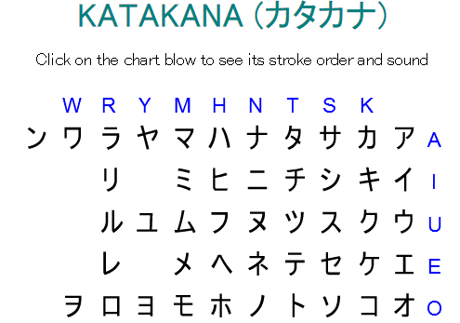
2. Recognizing katakana syllables and Writing katakana
http://genki.japantimes.co.jp/site/self/site/gakusyu/katakana.html
has same pronunciation as its corresponding hiragana

Slide 9
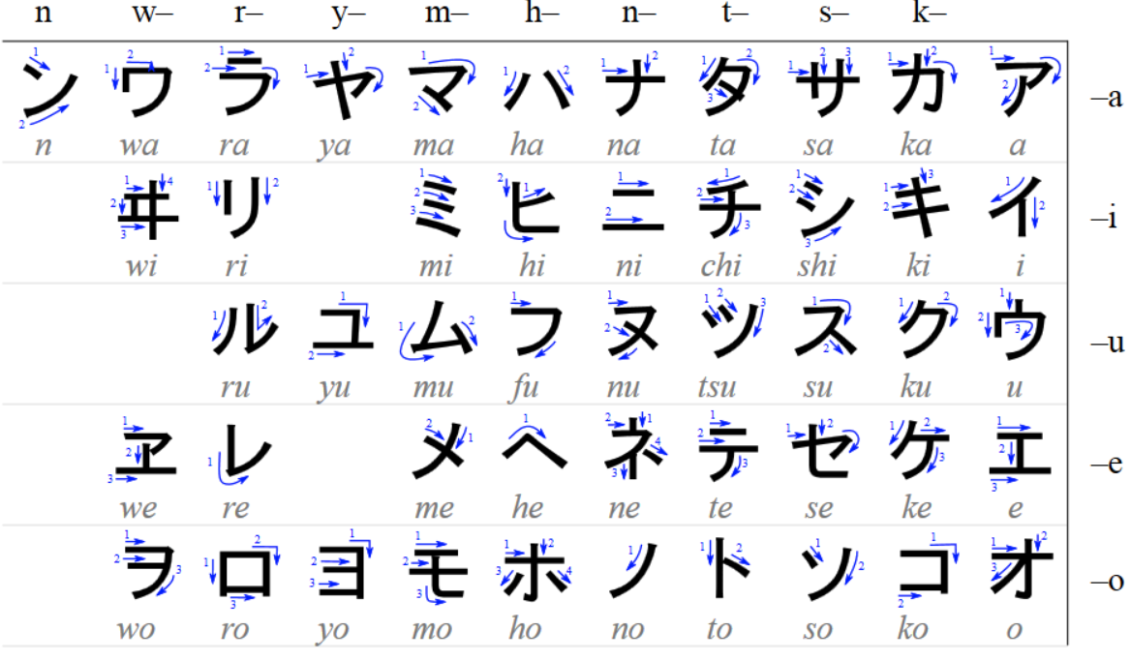
2. Recognizing katakana syllables and Writing katakana
https://upload.wikimedia.org/wikipedia/commons/0/0d/Table_katakana.svg

Slide 10
Japanese Alphabet Song - Study Hiragana katakana Chart - Learn to read Japanese alphabet table
https://www.youtube.com/watch?v=PAfi3D9K7lk

Slide 11
Pronunciation of つ
つ is pronounced as "tsu"
First, pronounce the word "Cats" and "tsunami", and then connect them, so it becomes "Catsunami." Then, take off "Ca" and "nami", it will sound like つ.
Or make the end sound of “cats~” longer, then, take off the “ca", it will sound like つ.

Slide 12
Pronunciation of は
*Particles attach themselves to phrases and indicate how the phrases relate to the rest of the sentence.
は (wa vs. ha)
Ha: used in regular words
Wa: used as particle*, Indicates the topic of a sentence.
こんにちは(wa)。 Hi.
こんばんは(wa)。 Good evening!
わたしは(wa) がくせいです。I am a student.
わたしのはは(haha)は(wa) やさしいです。My mother is kind.

Slide 13
Pronunciation of ふ
romaji: fu
Typing: both fu and hu will get ふ.
The actual sound: it is closer to the sound of “who” (in English)
The differences:
Fu(in food): make the quivering voice with the upper teeth and the bottom lip.
Who: make the quivering voice inside the throat. The upper teeth and the bottom lip, do not touch.
ふ: keep the shape of your mouth with “who”, and make quivering voice with your lips. Make sure both of your lips and tongue relaxed as you blow out the candles on the birthday cake.

Slide 14
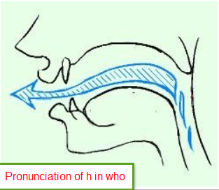
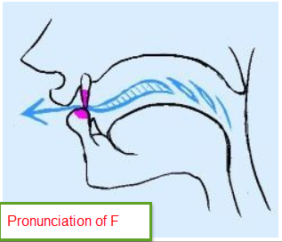
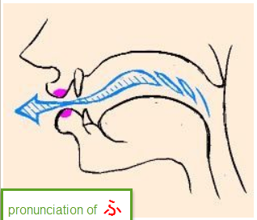
Pronunciation of ふ
From http://note.chiebukuro.yahoo.co.jp/detail/n223387

Slide 15
Pronunciation of へ
へ (he vs. e)
he: used in regular words
e: used as particle, indicates a direction.

Slide 16
Pronunciation of らりるれろ
http://www.textfugu.com/season-1/japanese-pronunciation/3-8/
also please check out:
https://www.youtube.com/watch?v=B1sfxemF9SE
https://www.youtube.com/watch?v=jUF5rAsaCKI

Slide 17
Pronunciation of を
を
Romaji: wo
Pronunciation: same as お(o)

Slide 18
Pronunciation of ん
Followed by a vowel or at the end of an utterance, ん indicates that the proceeding vowel is long and nasalized.
(nasalized vowels in French words such as "bon,"
Or in the English interjection "uh-uh" as in "no.")
Ex. れんあい rēai (romance) ほん hō (book)
Followed by n, t, d, s, and z sound, ん is pronounced as "n.“
ex. おんな onna (woman)
Followed by m, p, and b sounds, ん is pronounced as "m.“
ex. さんぽ sampo (stroll)
Followed by k and g sounds, ん is pronounced as "ng."
ex. まんが maŋga (comics)

Slide 19
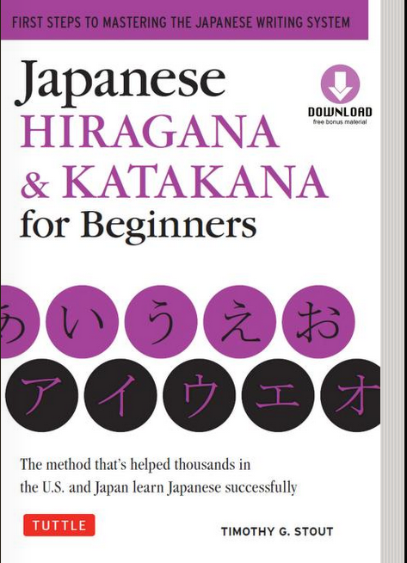
Help you to memorize
Free Book: Japanese Hiragana & Katakana for Beginners.

Slide 20
How to type Japanese
http://coscom.co.jp/learnjapanese801/index.html

Slide 21
How to type Japanese
romaji vs. actual typing
There is gap between the romaji and actual typing. For example:こんにちは romaji： konnichiwa actual typing: konnnichiha
Hint: type what you see, not what you hear.

Slide 22
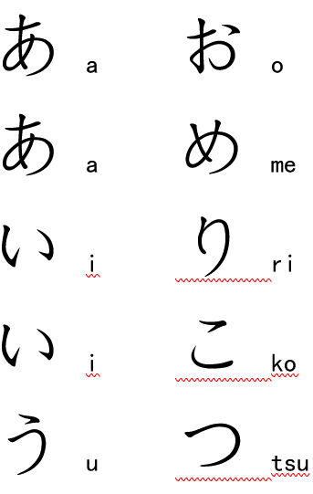
Shape comparing

Slide 23
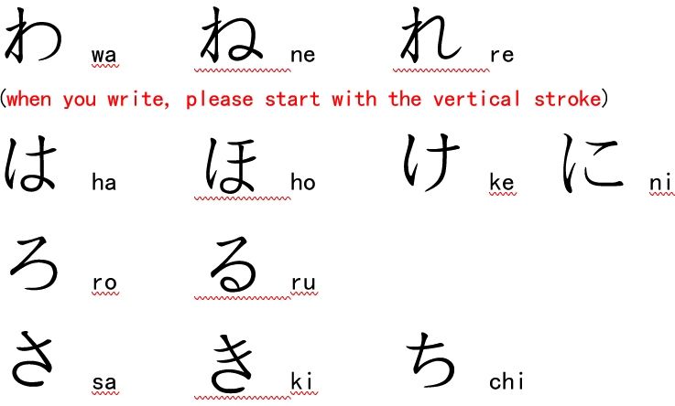
Shape comparing

Slide 24
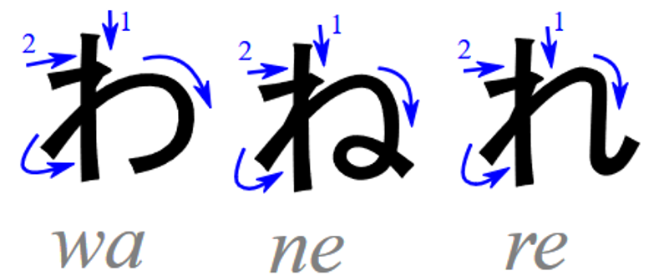
Shape comparing

Slide 25
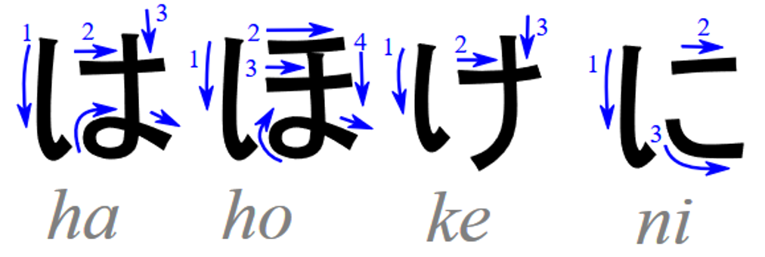
Shape comparing

Slide 26
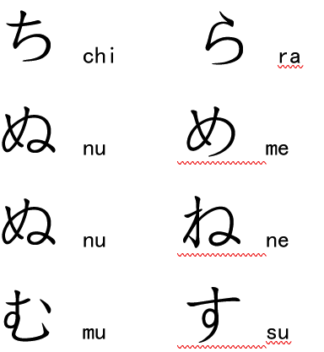
Shape comparing

Slide 27
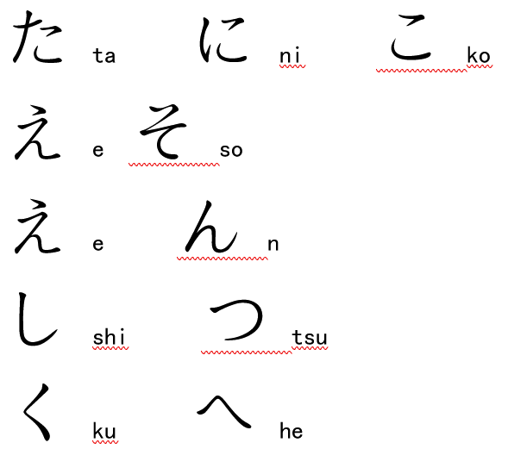
Shape comparing

Slide 28
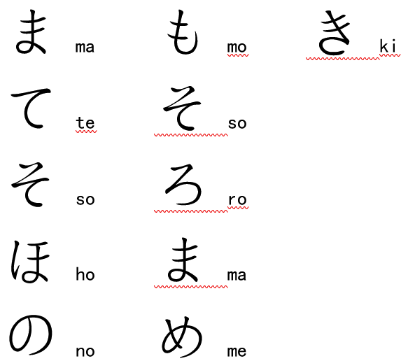
Shape comparing

Slide 29
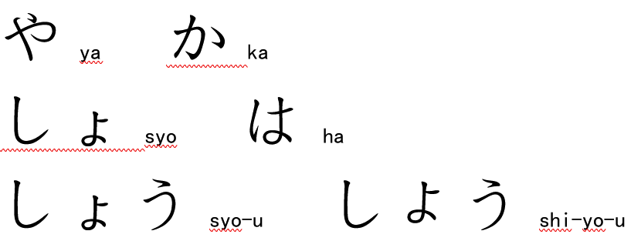
Shape comparing

Slide 30
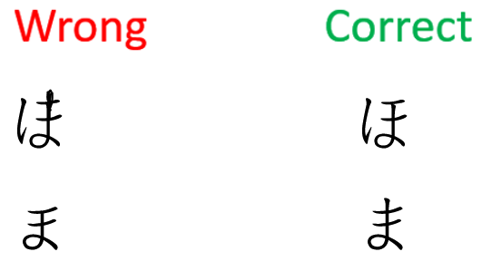
Shape comparing

Slide 31
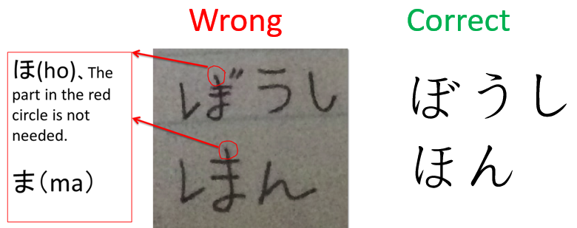
Shape comparing

Slide 32
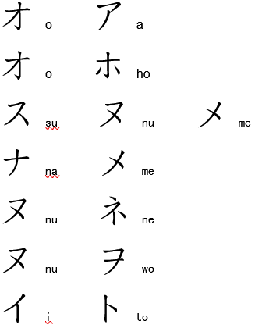
Shape comparing

Slide 33
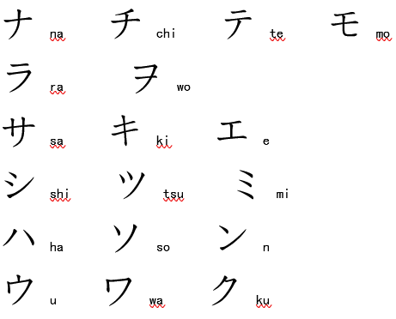
Shape comparing

Slide 34
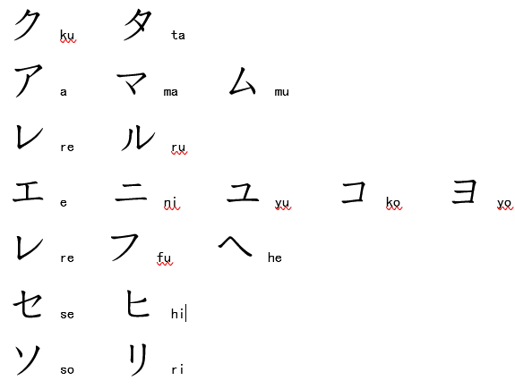
Shape comparing

Slide 35
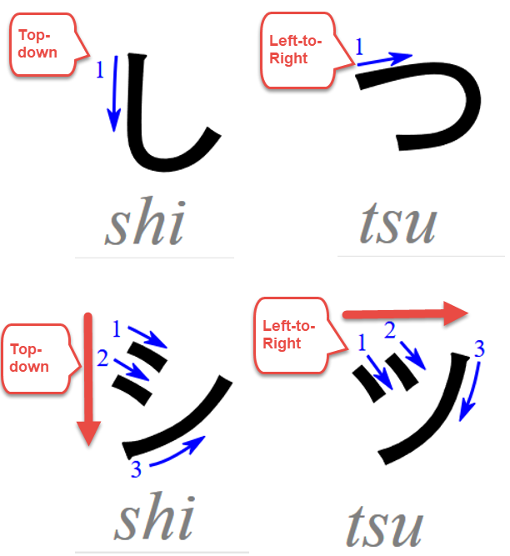
Shape comparing

Slide 36
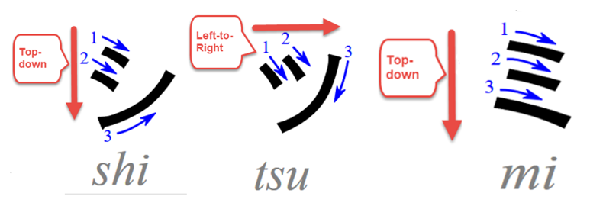
Shape comparing

Slide 37
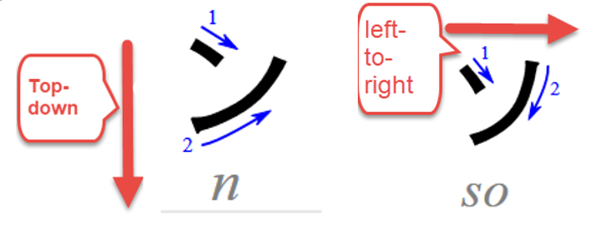
Shape comparing

Slide 38
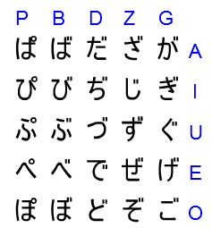
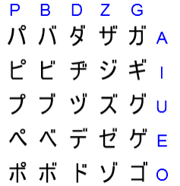
3. Voiced consonants
You can transcribe 23 additional sounds by adding diacritic marks. With a pair of short diagonal strokes (゛), the unvoiced consonants k, s, t, and h become voiced consonants g, z, d, and b, respectively. The consonant h changes to p with the addition of a small circle (゜).

Slide 39
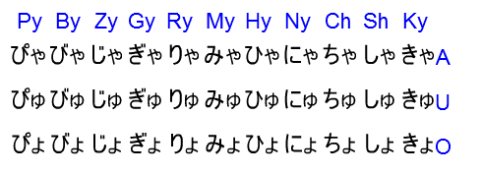
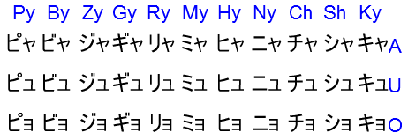
4. Contracted sounds
Small や, ゆ, and よ follow after letters in the second column (i-vowel hiragana, except い) and are used to transcribe contracted sounds.
The contracted sound represents a single syllable.

Slide 40
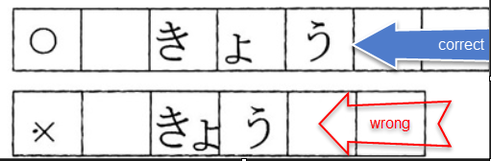
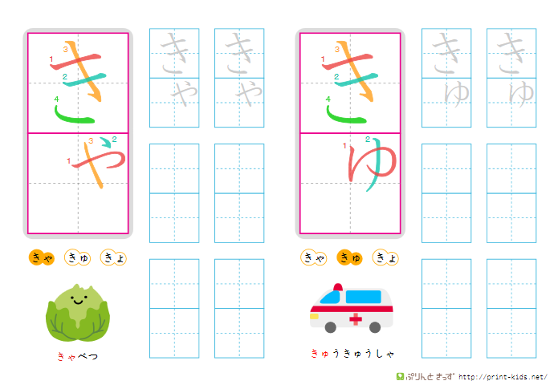
Contracted sounds
Should be written in two grids even though it is just one syllable.
The ゃ, ゅ, ょ
Should be written small, half of the size of the regular kana.
Should be on the left bottom when written horizontally.
Should be on the right top when written vertically.

Slide 41
Contracted sounds
For example, when we write きょ horizontally, the small ょ will take a whole grid, but stays on the left bottom of the next grid.
For example, when we write きゃ vertically, the small ゃ will take a whole grid, but stays on the right top of the next grid.

Slide 42
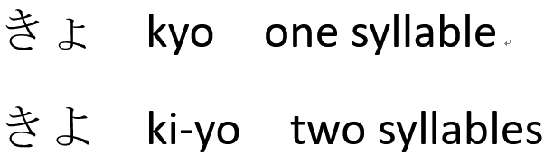
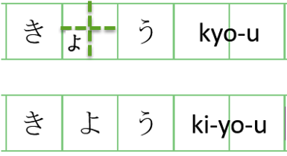
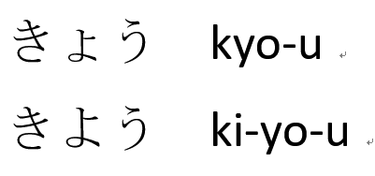
4. Contracted sounds

Slide 43
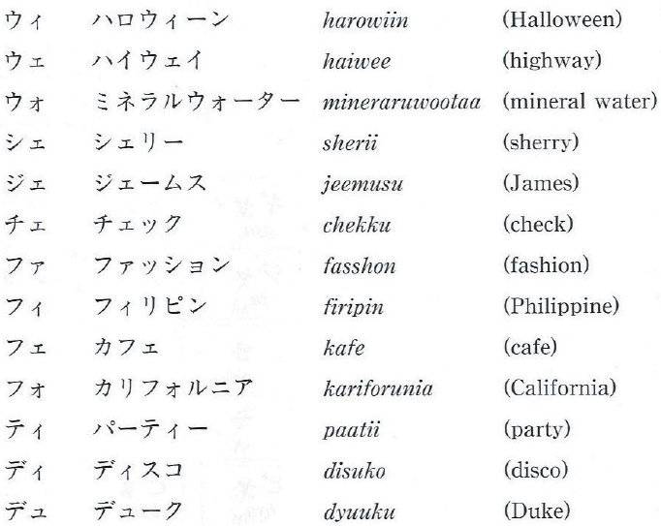
4. Contracted sounds

Slide 44
4. Contracted sounds
The sound "v" is sometimes written with ウ゛, the word "Venus" is sometimes written as ビーナス or ウ゛ィーナス.

Slide 45
5. Double consonants
かった katta (won) cf. かた kata (shoulder)
さっか sakka (writer)
はっぱ happa (leaf)
ざっし zasshi (magazine)
small letter, っ,( which is half of the size of the regular つ), which is used when transcribing double consonants such as tt and pp.

Slide 46
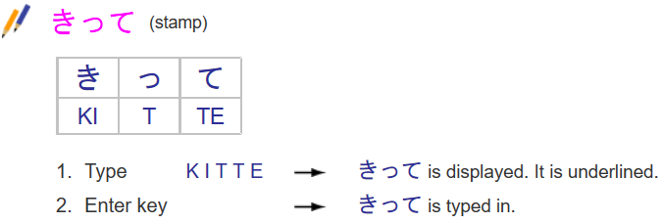
5. Double consonants
How to Input Hiragana Double Consonants

Slide 47
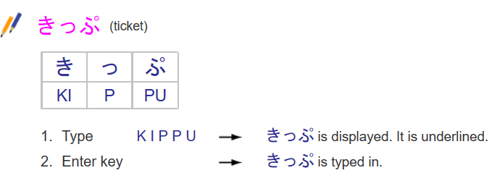
5. Double consonants
How to Input Hiragana Double Consonants
More at http://coscom.co.jp/learnjapanese801/lesson04.html

Slide 48
5. Double consonants
How to pronounce double consonants
かった katta (won)
さっか sakka (writer)
はっぱ happa (leaf)
ざっし zasshi (magazine)
A chocked pause, feeling like you got choked and stayed in that situation for one beat.
Pronounce the phrases "black cat", "bad dog". Holding your tongue in the position at the preceding vowel, and then release the breath in a larger burst than usual.

Slide 49
5. Double consonants summary of small っ vs. big つ
The size
small っ: half of the size of big つ.
big つ: regular size as normal letter.
Pronunciation
small っ: is NOT pronounced as tsu, is just a chocked pause.
big つ: pronounced as tsu.

Slide 50
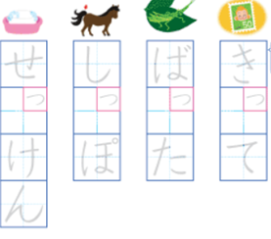
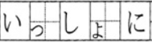

5. Double consonants summary of small っ vs. big つ
Writing
small っ: on the left bottom when it is written in horizontal, right top in vertical.
big つ: the center of the grid.

Slide 51
5. Double consonants summary of small っ vs. big つ
type
small っ: type two consonants that are behind theっ.
eg: かった katta (won) type tt to get theっ
big つ: type tsu or tu

Slide 52
5. Double consonants
さんねん sannen (three years)
あんない annai (guide)
Note double consonant n's as in sannen (three years) are written with ん + a hiragana with an initial n sound (な, に, ぬ, ね, の).

Slide 53
6. Long vowels
aa おばあさん obaasan (grandmother) cf. おばさん obasan (aunt)
ii おじいさん ojiisan (grandfather) cf. おじさん ojisan (uncle)
uu すうじ suuji (number)
When the same vowel is placed one right after the other, the pronunciation of the vowel becomes about twice as long as the single vowel. Be sure to hold the sound long enough, because the length of the vowel can change one word to another.

Slide 54
6. Long vowels
ee The long ee sound is usually transcribed by adding an い to an e-vowel hiragana. There are a few words, however, in which え is used instead of い .
えいが eega (movie)
おねえさん oneesan (big sister)
oo The long oo sound is in most cases transcribed by adding an う to an o-vowel hiragana. There are, however, words in which the long vowel is transcribed with an お, for historical reasons.
ほうりつ hooritsu (law)
とお too (ten)

Slide 55
6. Long vowels
The long vowels are written with ー in katakana
カー kaa (car)
スキー sukii (ski)
スーツ suutsu (suit)
ケーキ keeki (cake)
ボール booru (ball)

Slide 56
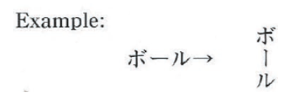
6. Long vowels
When you write vertically, the ー mark needs to be written vertically also

Slide 57
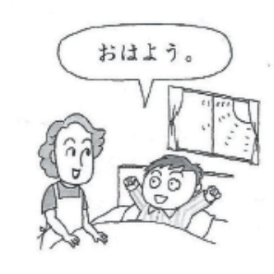
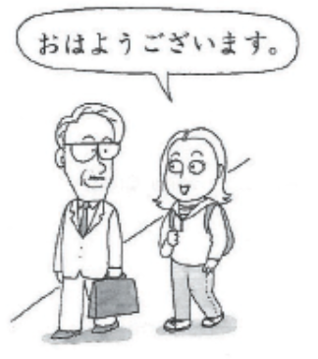
7. Greetings
おはよう。
ohayoo.
Good morning.
おはよう ございます。
ohayoo gozaimasu.
Good morning (polite).

Slide 58
7. Greetings
おはよう ございます
ohayoo gozaimasu.
Good morning (polite).
おはよう。
ohayoo.
Good morning.
used before noon
used in casual meeting in the afternoon or even at night when they see their classmates or coworkers for the first time that day.

Slide 59
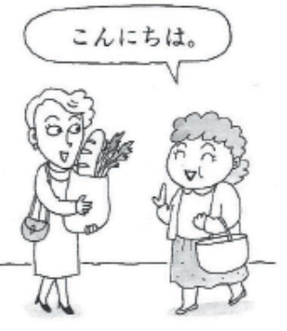
7. Greetings
こんにちは。
Pronounce: Ko n ni chi wa.
Good afternoon.
Type: Ko nn ni chi ha.
Type what you see,
not what you hear

Slide 60
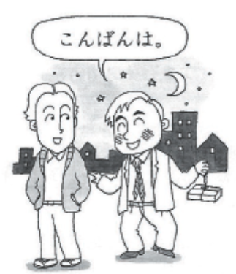
7. Greetings
こんばんは。
Ko n ba n wa.
Good evening.

Slide 61
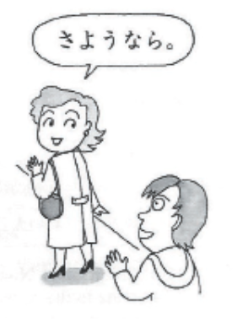
7. Greetings
さようなら。
Sa yo o na ra.
Good-bye.

Slide 62
7. Greetings
さようなら。sayoonara. Good-bye.
The speaker does not expect to see the person spoken to before she "turns a page in her life"; not until a new day arrives, or until fate brings the two together again.
It sounds dramatic and ritualistic, and its daily use is largely restricted to school children taking leave of their teachers.
じゃあ、また。Jaa, mata. (between friends, expecting to see each other again fairly soon)
しつれいします。Shitsureeshimasu. (taking leave from a professor's office)

Slide 63
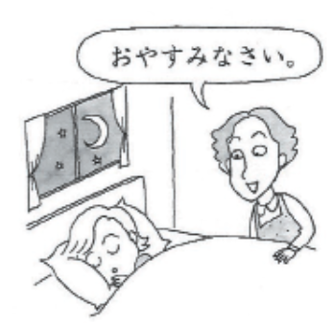
7. Greetings
おやすみ(なさい)。
O ya su mi (na sa i).
Good night.

Slide 64
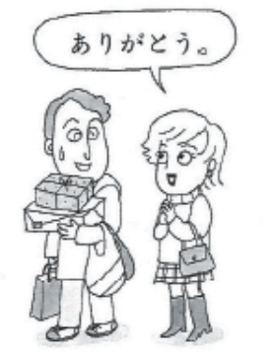
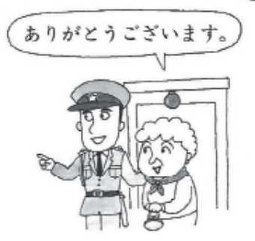
7. Greetings
ありがとう。
arigatoo.
Thank you.
ありがとう ございます。
arigatoo gozaimasu.
Thank you (polite).

Slide 65
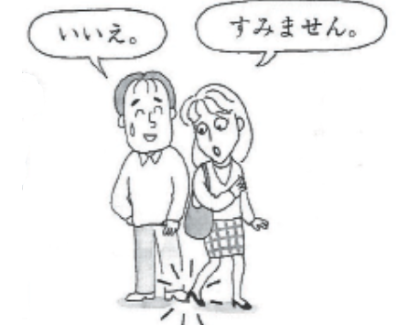
7. Greetings
すみません。
Su mi ma se n.
Excuse me; I'm sorry.
いいえ。
iie.
No; Not at all.

Slide 66
7. Greetings
すみません。 sumimasen.
(1) "Excuse me," to get another person's attention
(2) "I'm sorry," to apologize for the trouble you have caused, or
(3) "Thank you," to show appreciation for what someone has done for you.

Slide 67
7. Greetings
いいえ。 iie. No; Not at all.
used to express the English phrase "Don't mention it," or "You are welcome," with which you point out that one is not required to feel obligated for what you have done for them.

Slide 68
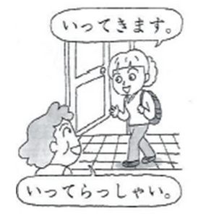
7. Greetings
いってきます。
I tte ki ma su.
I'll go and come back.
いってらっしゃい。
I tte ra ssha i.
Please go and come back.

Slide 69

7. Greetings
ただいま。
tadaima.
I'm home.
おかえり（なさい）。
O ka e ri (na sa i).
Welcome home.

Slide 70


7. Greetings
いただきます。
I ta da ki ma su.
Thank you for the meal (before eating).
ごちそうさま(でした)。
Go chi so o sa ma (de shi ta).
Thank you for the meal (after eating).

Slide 71

7. Greetings
はじめまして。
Ha ji me ma shi te.
How do you do?
よろしく おねがいします。
Yo ro shi ku o ne ga i shi ma su.
Nice to meet you.

Slide 72

Thank you!
ありがとうございます。
Arigatou gozaimasu.

